Slide 1
CHESS ENGINE
HSC Major Project
By Allan Luong

Slide 2
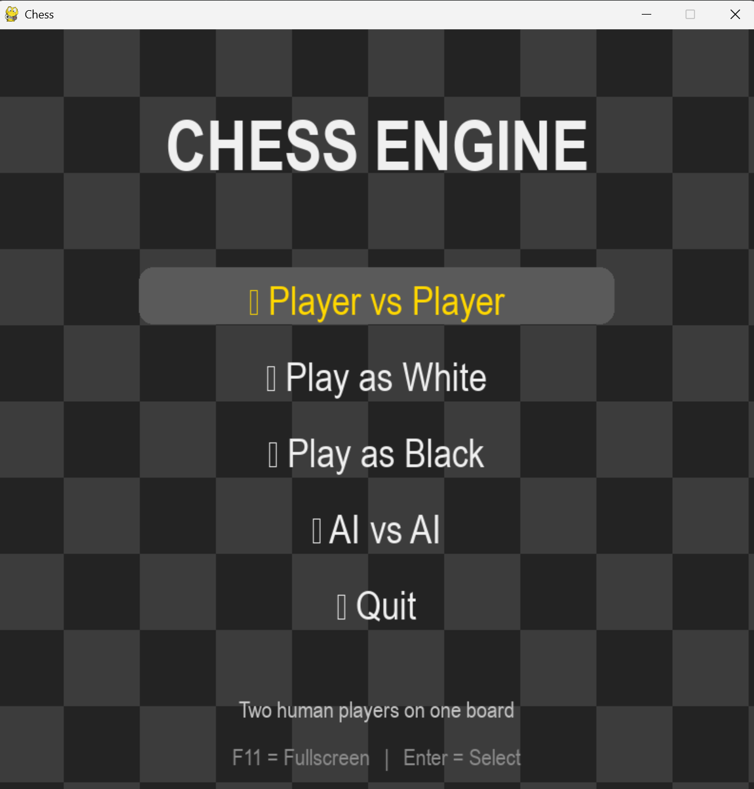
PROBLEM STATEMENT
The Problem:
Many existing chess programs are designed for experienced players and can be difficult for beginner to understand.
The Solution:
Develop a custom chess engine that:
Allows two-player games
Includes AI opponents
Demonstrates software engineering principles
Provides a clean graphical interface
Intended Users
Students
Teachers
Beginner Players

Slide 3
DEVELOPMENT METHODOLOGY
SPRINT ONE
SPRINT THREE
Chess Board
Pieces
- Check & Checkmate
SPRINT TWO
SPRINT FOUR
Legal Movement
Capturing
AI
User Interface
Testing

Slide 4
TECHNOLOGIES USED
Softwares & Library
Easy to Develop
Large Community
Great for AI Algorithm
PYTHON
VSC
Python Extension
GitHub Integration
Debugging Tools
Pygame
Copy
Random
os
LIBRARIES

Slide 5
CHESS ENGINE ARCHITECTURE
Main Program
│
▼
Game
│
┌────┴────┐
▼ ▼
Board AI
│ │
▼ ▼
Pieces Minimax
│
▼
Move Validation
Main Modules
Main.py
Board.py
Game.py
AI.py
Piece.py
Menu.py

Slide 6
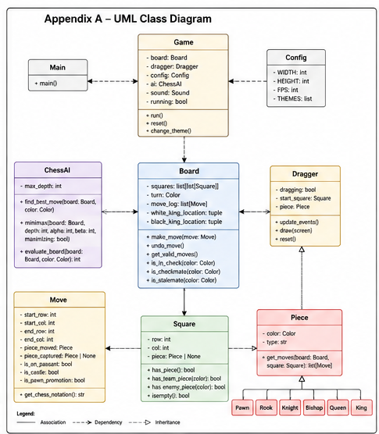
UML DIAGRAMS

Slide 7
SECURITY & RELIABILITY
INPUT VALIDATION
EXCEPTION HANDLING
Only legal moves accepted
Prevents invalid board positions
Prevents crashes
Handles unexpected user actions
RELIABILITY
MAINTAINABILITY
Illegal moves rejected
Board state always validated
Check/checkmate detection
Modular classes
Commented code
GitHub version control

Slide 8
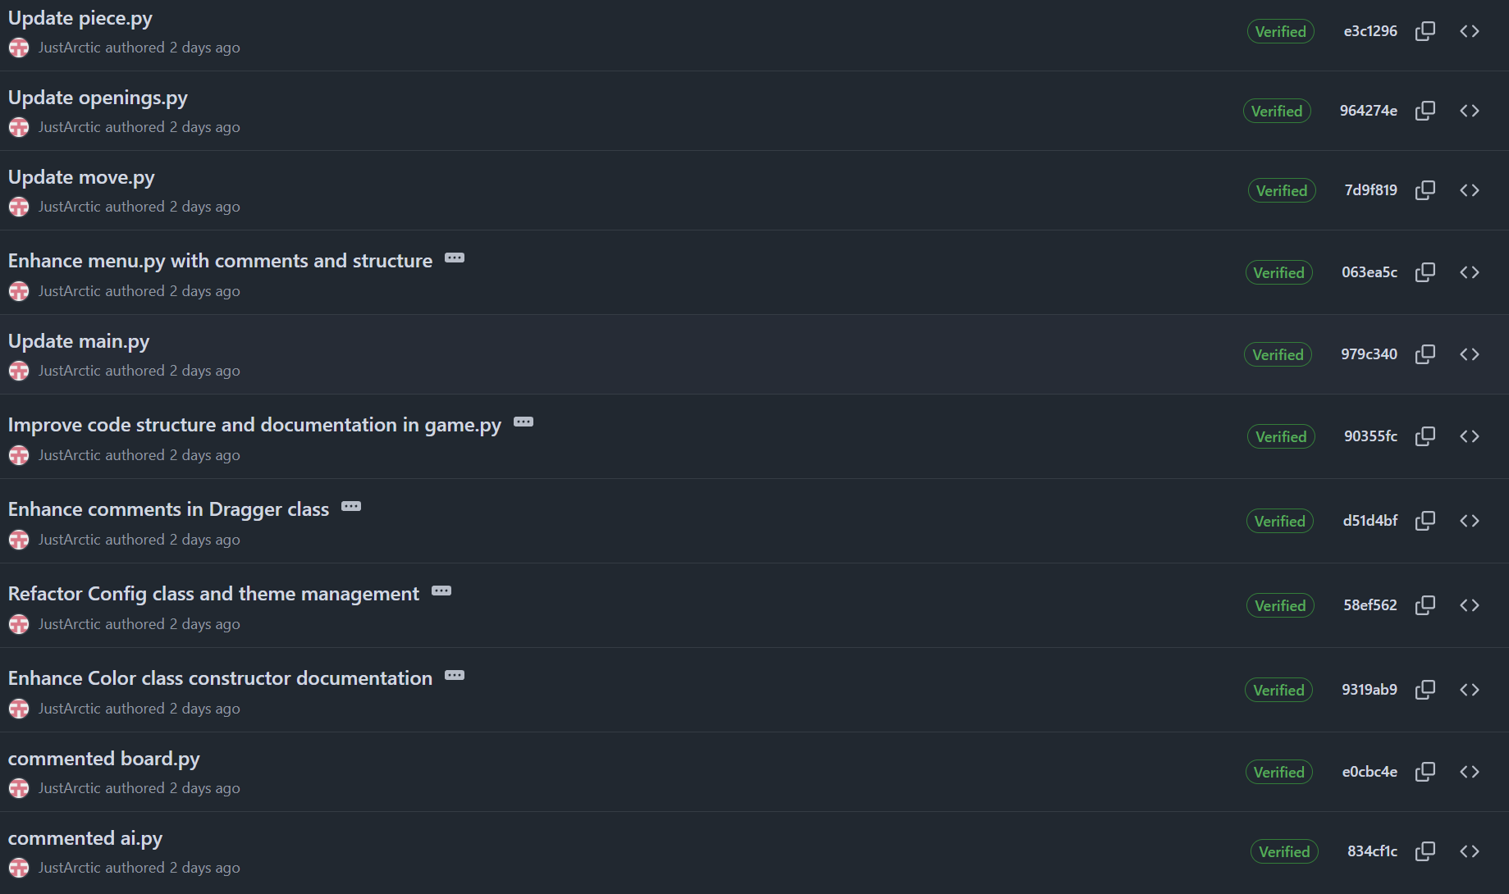
GITHUB EVIDENCE
GitHub Version Control

Slide 9
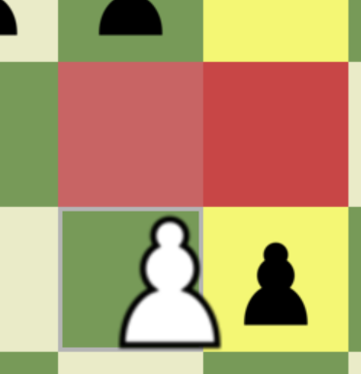
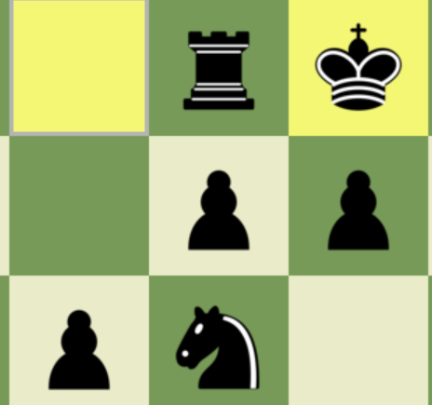
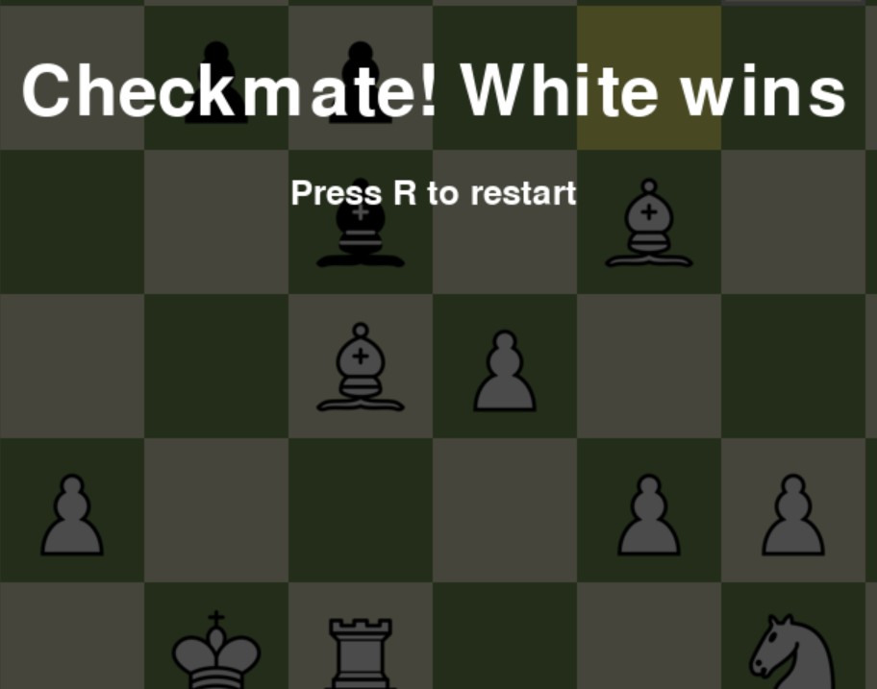
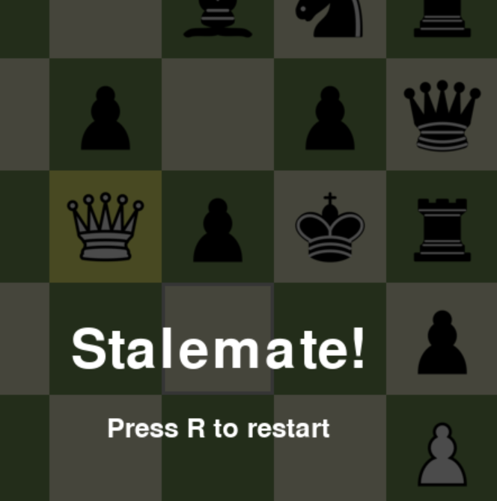
THESE ARE FIVE COLUMNS
EN PASSANT
CASTLING
CHECKMATE
STALEMATE

Slide 10
CHALLENGES
AI Development
Debugging
Smoothness
No tutorial used when making the chess AI
Screen would freezes, AI would loop moves and AI took to long to move
Screen would freeze if not players turn
In Player vs AI

Slide 11
Future Improvements
Possible Enhancements
Stronger AI
Online Multiplayer
Difficulty Levels
Move Analysis
Game Saving
Undo Feature
Timers

Slide 12
THANKS
Live Demonstration

